Slide 1
Predicting Clients Who Default on Their Home Equity Lines of Credit using Machine Learning Algorithms
Matt McDonnell
IST 652: Scripting for Data Analysis
School of Information Studies
Syracuse University
mcdmatt@bu.edu

Slide 2
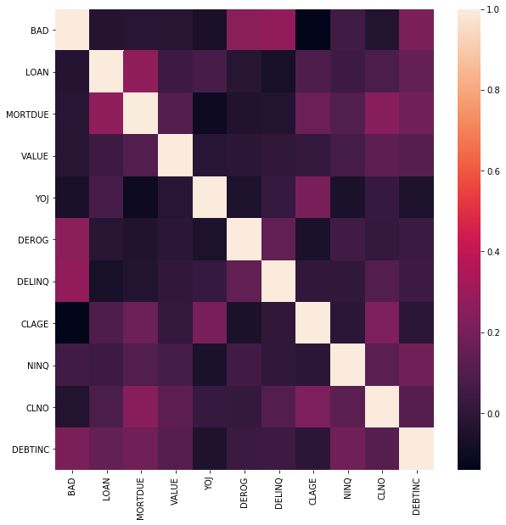
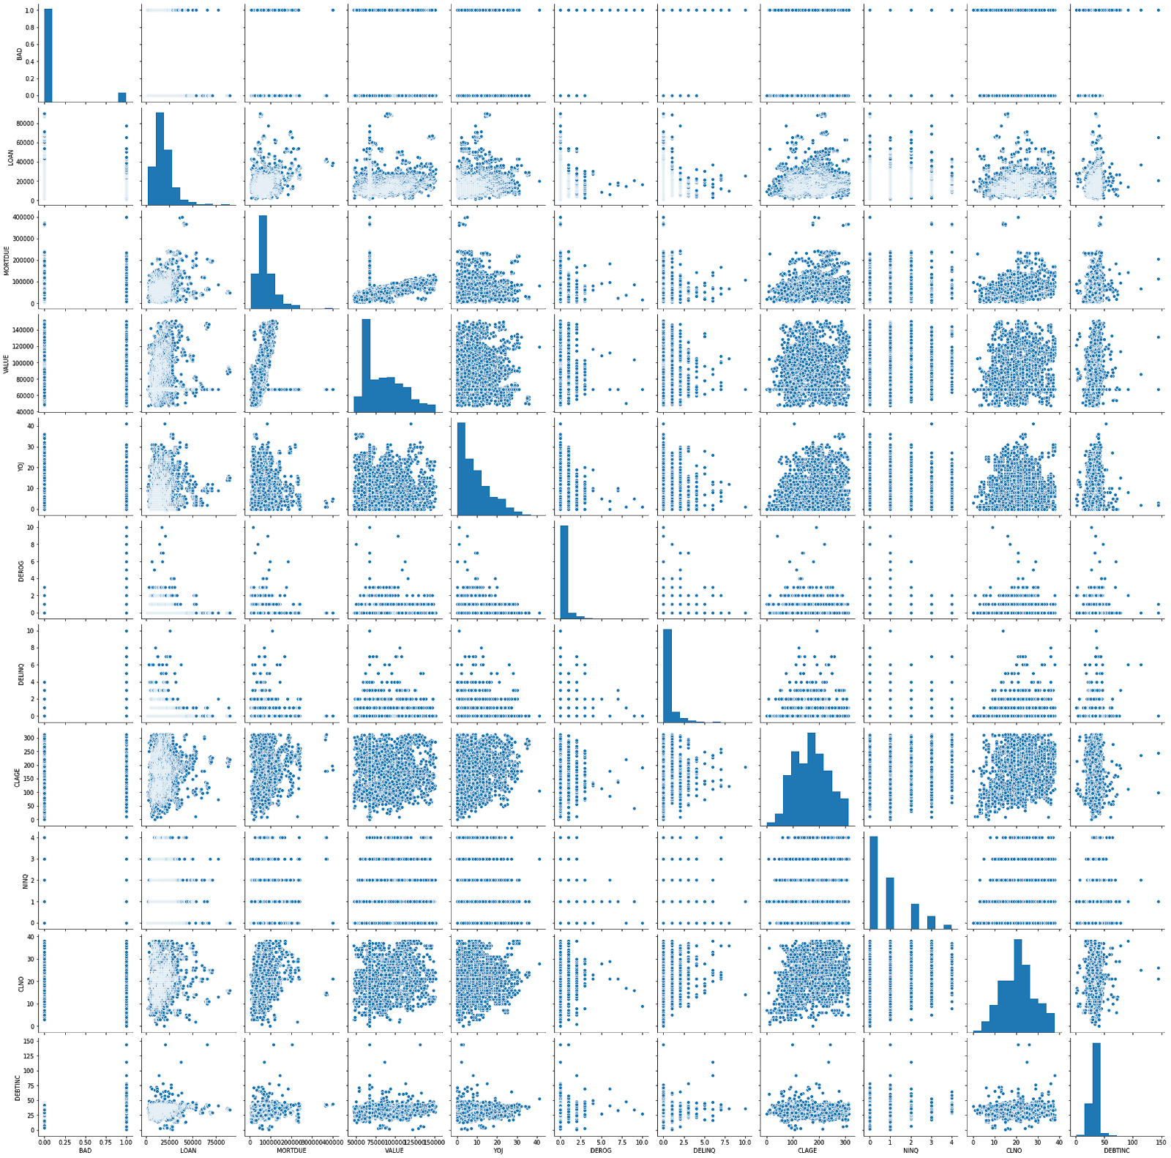
Exploratory Data Analysis (EDA) and Visualization

Slide 3
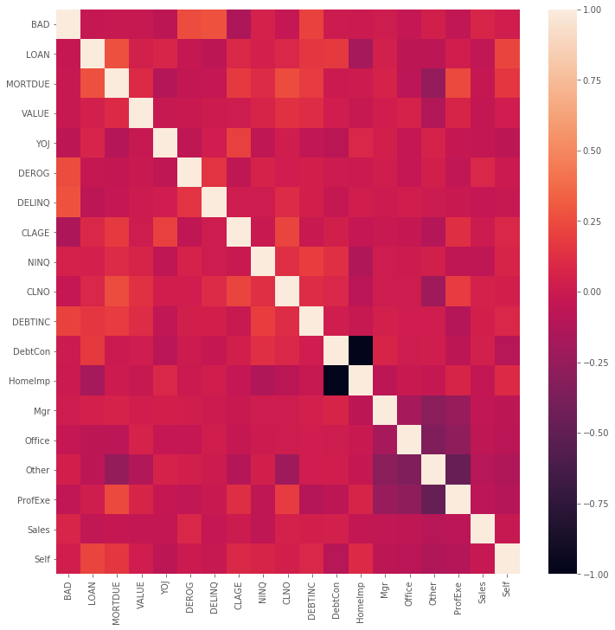
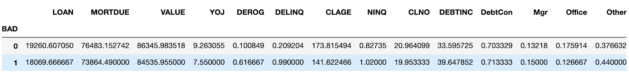
Problem Framing and Predictive Method Development

Slide 4
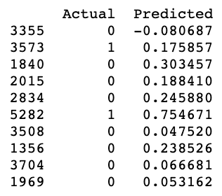
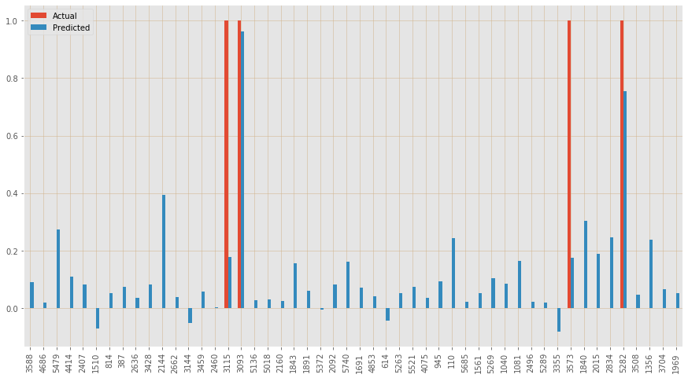
Supervised Machine Learning Using Linear Regression

Slide 5
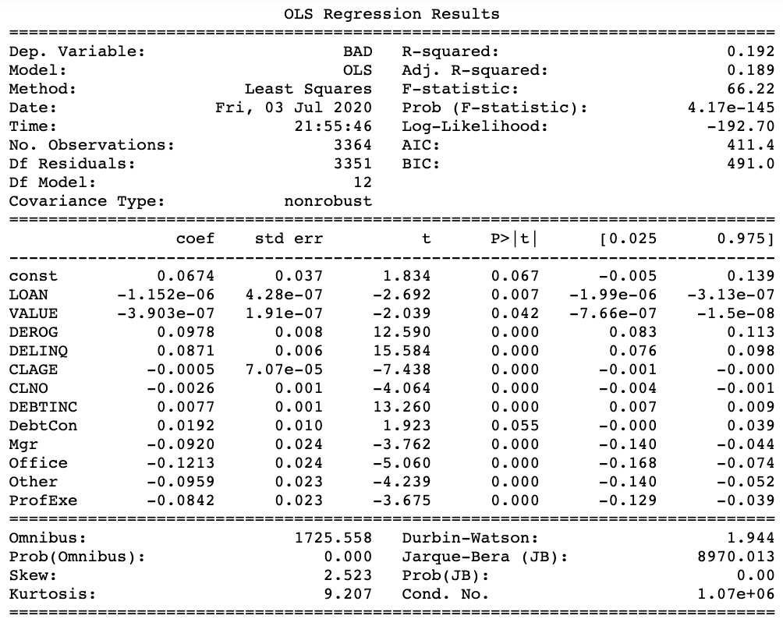
Supervised Machine Learning Using Linear Regression

Slide 6
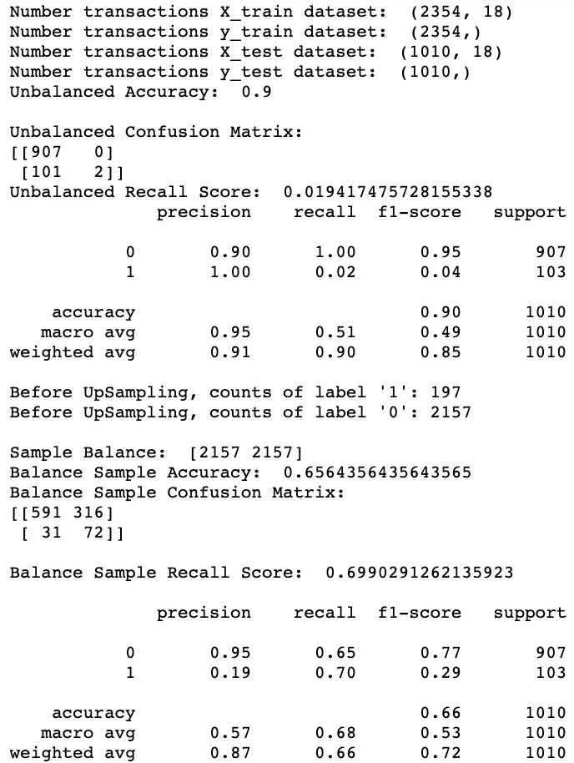
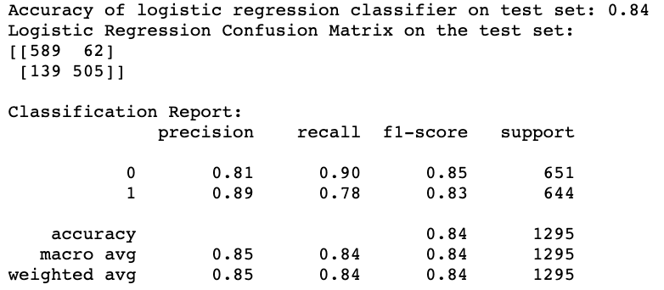
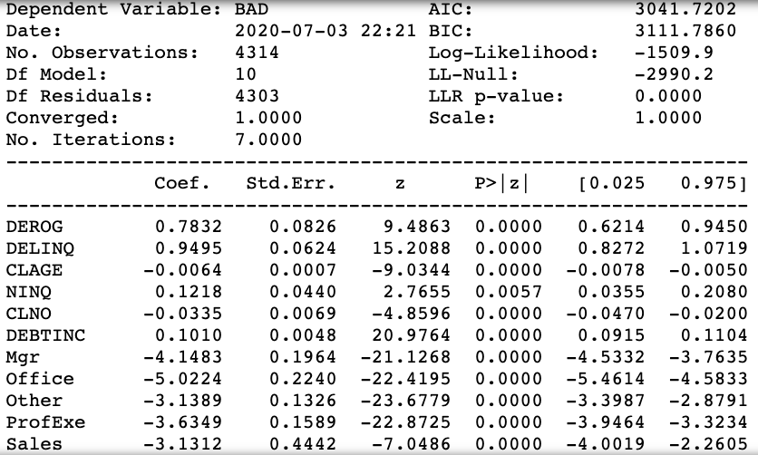
Supervised Machine Learning Using Logistic Regression

Slide 7
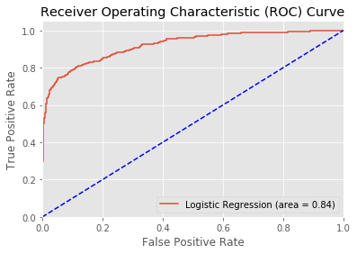
Supervised Machine Learning Using Logistic Regression

Slide 8
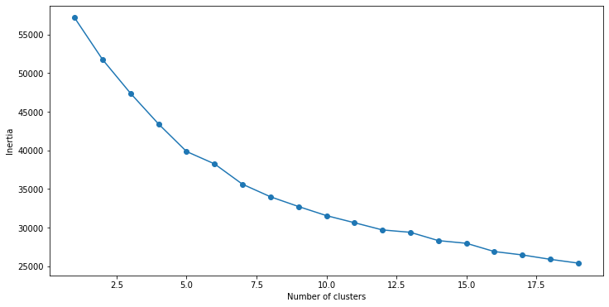
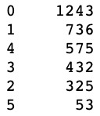
Unsupervised Machine Learning Using K-Means Clustering

Slide 9
References
https://github.com/susanli2016/Machine- Learning-with-Python/blob/master/Logistic%20Regression%20balanced.ipynb
https://www.analyticsvidhya.com/blog/2019/08/comprehensive-guide-k-means-clustering/#comment-160970
https://kite.com/blog/python/smote-python-imbalanced-learn-for-oversampling/
https://medium.com/@saeedAR/smote-and-near-miss-in-python-machine-learning-in-imbalanced-datasets-b7976d9a7a79
https://jakevdp.github.io/PythonDataScienceHandbook/05.11-k-means.html
https://towardsdatascience.com/building-a-logistic-regression-in-python-step-by-step-becd4d56c9c8

